Slide 1
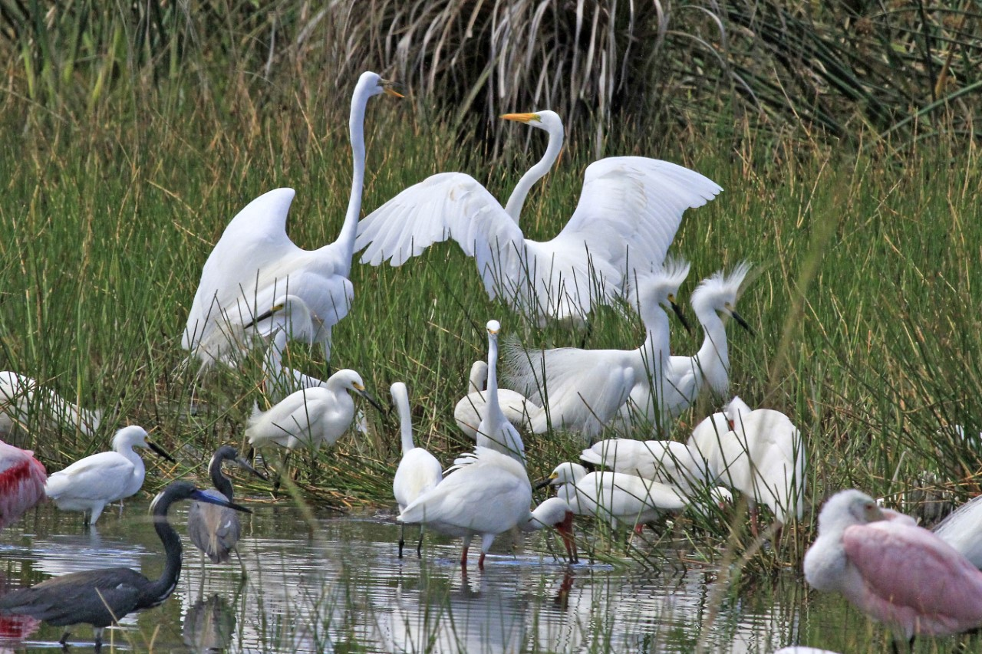
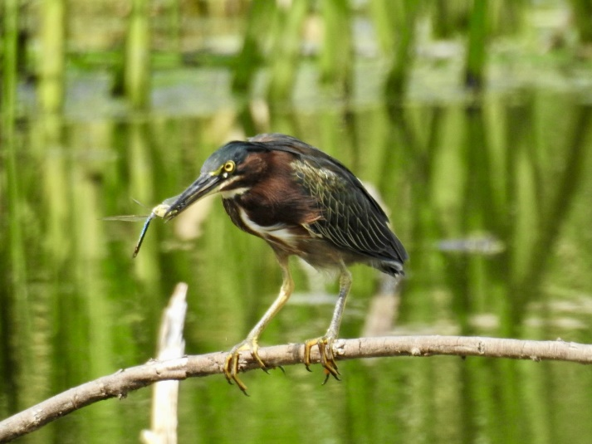
The Value of Shallow Wetlands
FIELD GUIDE
What are Wetlands?
Wetlands are diverse freshwater ecosystems that are saturated with water either seasonally or permanently.
What do They Provide?
Wetlands not only provide a habitat for thousands of species, but they also provide ecosystem services that supply us with flood protection, erosion control, and clean drinking water. Wetlands serve as natural filters to improve the quality of water by removing harmful pollutants.
Wetland Birds Foraging in Bonita Bay
Herbaceous Wetlands/ Marshes Forested Wetlands/Swamps
•
Dominated by grasses, sedges, and rushes
•
Dominated by trees and woody vegetation
•
Vegetation coverage is very dense
•
Contains more than 1/3 tree coverage
•
Contains less than 1/3 tree coverage
•
Soils are flooded for only a portion of the year
•
Spider-Lily, Alligator Flag, Sand Cord Grass, Blue Flag Iris, and Pickerelweed can be found here
•
Mangrove Swamps and Cypress Swamps are examples of Forested Wetlands
•
These wetlands can often be called “meadows” or “wet prairie”
•
The Florida Snapping Turtle can be found here!
Permanent Wetlands
Why are Shallow Wetlands Important?
•
Contains water throughout the entire year
Shallow wetlands provide South Florida with clean drinking water by removing sediments, phosphates, and nitrates from the water and replenishing our aquifers. This vital process is facilitated by native wetland plants. Shallow wetlands, such as the marshes and swamps, serve as foraging areas for wading birds. Wetlands located close to bird nesting rookeries are especially beneficial for chick rearing, as adult birds don’t have to fly as far to find food.
•
Hydrophytic plants, or "water loving” plants, dominate these wetlands as they are adapted to survive in flooded conditions
•
These wetlands are made up of rivers, lakes, swales and sloughs
•
Duckweed, Water Hemlock, and Lance Leaf Arrowhead can be found here
•
Bonita Bay has many permanent wetlands!
Fu n F a c t s
§ Bonita Bays wetlands are designed to withstand heavy rains by storing storm water.
§ Wetlands are nicknamed “ Mother Natures Kidneys”!
§ The world's largest protected wetland is Llanos de Moxos in Bolivia that spans over 17 million acres.
§ Over 19,000 wildlife and bird species utilize wetlands as their habitat around the world.
§ World’s Wetlands Day is celebrated annually on February 2nd
MaciasWildlifeSociety.org | The Macias Wildlife Society is a 501(c)(3) corporation. All donations are tax deductible | PO Box 366002, Bonita Springs, FL 34136

Slide 2
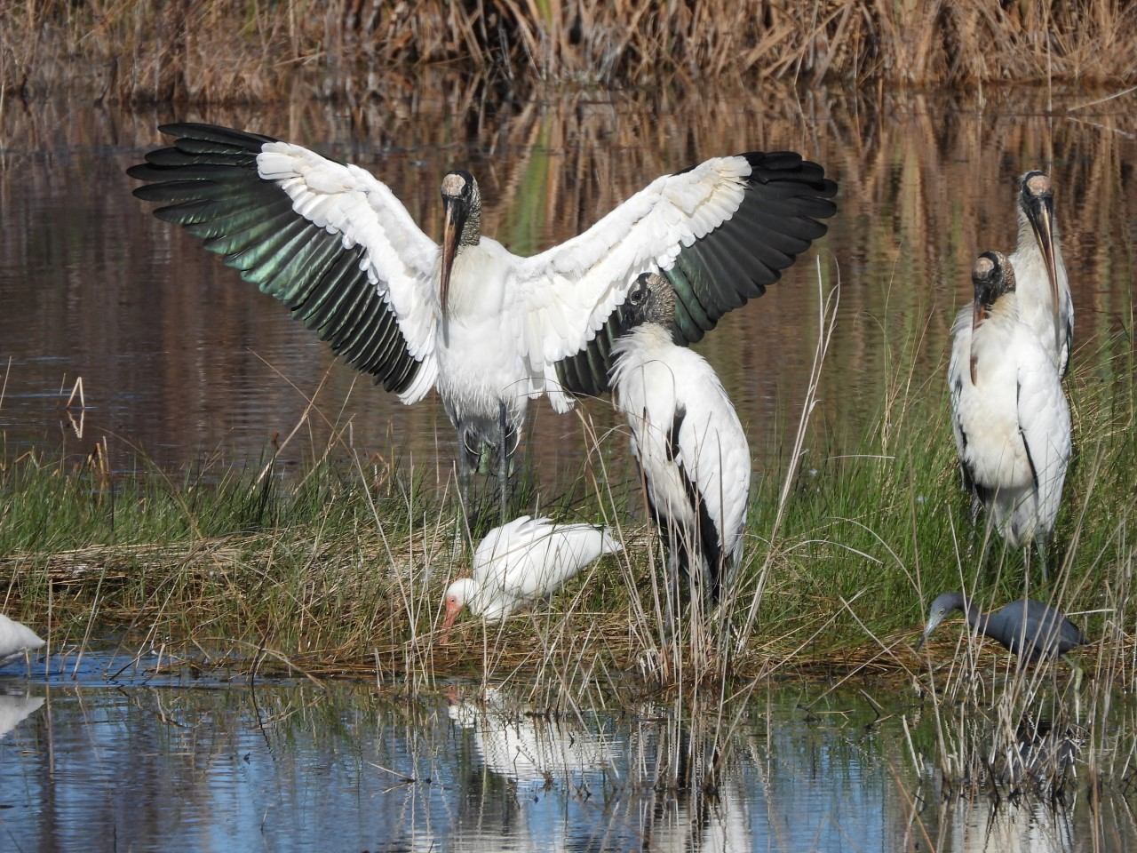
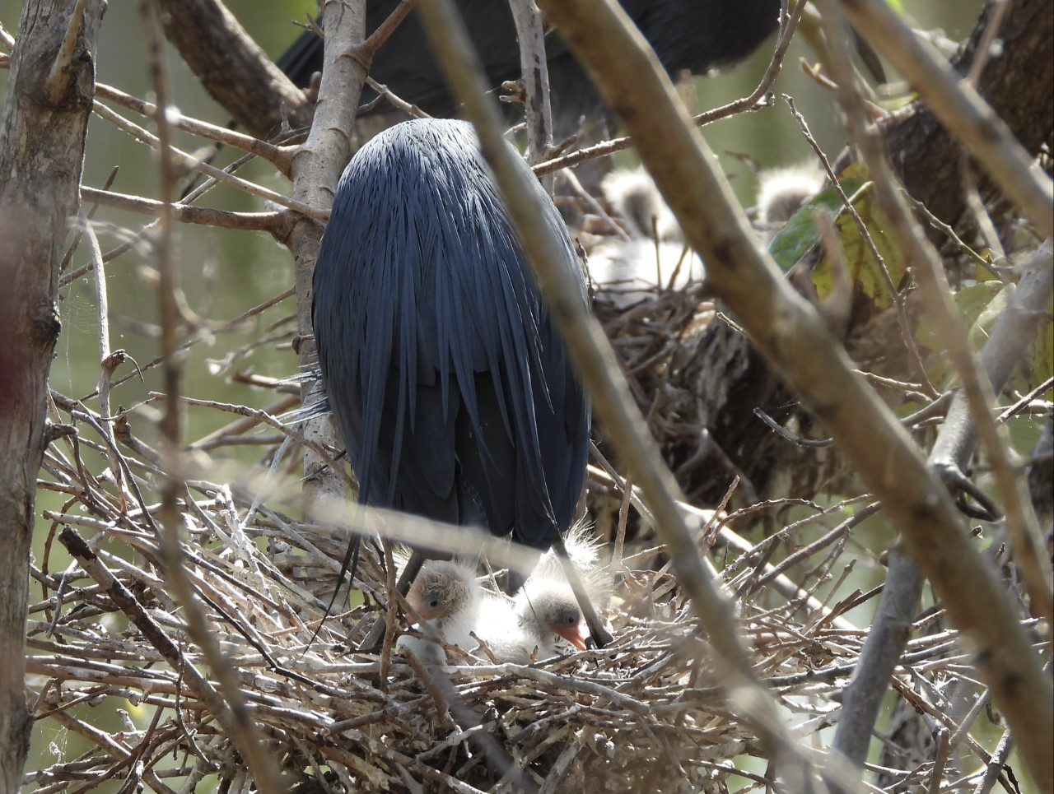
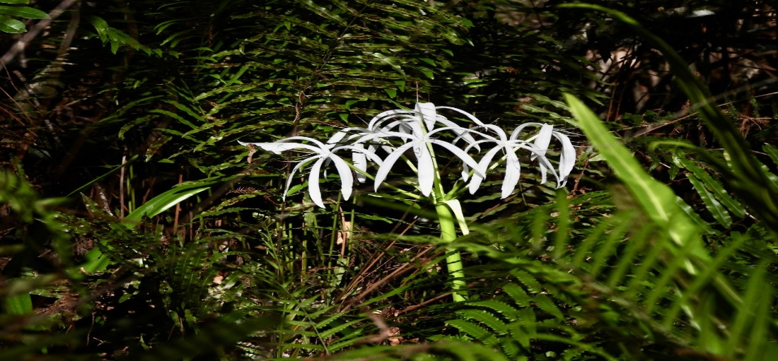
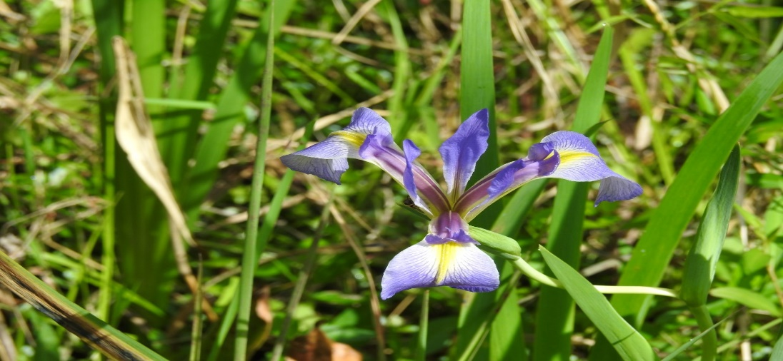
FI E L D G U I D E
The Wetland Species Photo Gallery
1. Wood Stork in Spike Rush
3. Swamp Lily Among the Swamp Ferns
2. Little Blue Heron with Chicks
4. Blue Flag Iris
Ad d i t i o n a l N o t e s
Ø The Wood stork is listed as threatened due to habitat loss.
Ø Wood storks are known as indicator species! This means that the Wood storks are used to determined the health of an environment. If there are no Wood storks, the environment is deemed unhealthy.
Ø The Swamp Lily is toxic! You may touch but don’t eat it!
Ø Swamp ferns are native to Florida and can grow to 2-4 feet in height.
Ø Woody plant species provide wetland birds with nesting habitat to support their young. This is why we need to protect our wetlands.
Ø The Blue Flag Iris is a flowering plant that only grows in wetlands and it a popular choice for gardening in Florida!
MaciasWildlifeSociety.org | The Macias Wildlife Society is a 501(c)(3) corporation. All donations are tax deductible | PO Box 366002, Bonita Springs, FL 34136

Slide 3
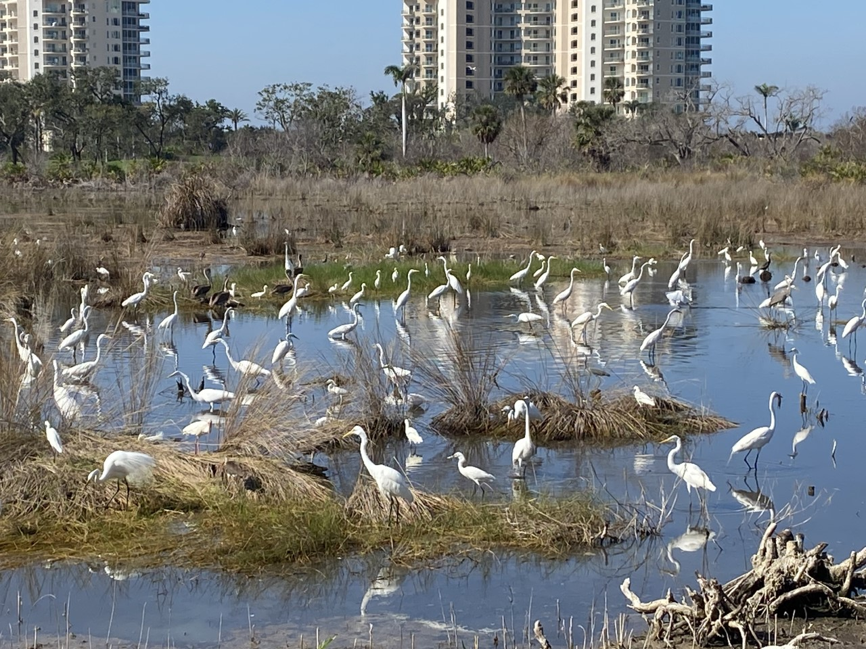
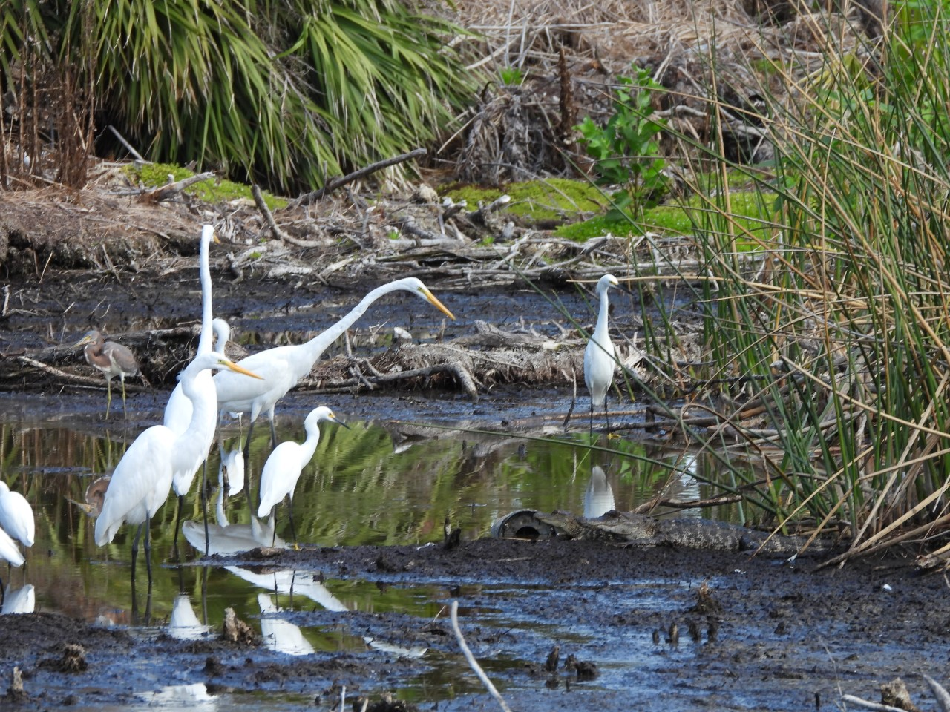
FI E L D G U I D E
The Value of Shallow Wetlands
Wetlands offer numerous benefits, one of which is their ability to serve as a habitat for a diverse range of plants and animals. They are among the most productive ecosystems on Earth, providing homes to numerous rare and endangered species. The wetlands in Bonita Bay, for instance, serve as foraging areas for wading birds that nest in nearby rookeries and add to the area's beauty and ecological richness. In order to sustain this dynamic, it is crucial that we take measures to prevent wetlands from turning into monocultures. Certain plants such as, Carolina Willow, Cattails, and Bulrush, have the potential to dominate wetlands and deprive wading birds of their foraging grounds. To counter this, residential communities like Bonita Bay remove these monocultures by regularly treating and cutting them. Such maintenance is crucial to preserve the health and biodiversity of wetlands.
1. View of the “Salad Bowl” Wetland in Bonita Bay
2. Great Egret Pointing Out the Baby Alligators
Ho w Y o u C a n H e l p
Ø Learn about your local wetlands
Ø Reduce, Reuse, and Recycle. Even this simple statement is enough to help protect wetlands!
Ø Find a volunteer group that participates in wetland cleanup
Ø Respect wetlands. Enjoy the beauty they have to offer.
Ø Plant native plants. Planting invasive plants can bring harm to the environment. Opting for native plants when appropriate will help prevent the spread of invasives.
Ø Be smart about your lawn fertilizer. Lawn fertilizer can contain pollutants that can harm wetlands and other environments. Invest in fertilizers that use non-nitrogen supplements
Ø Use non-toxic products. Don’t spray heavy chemicals on your lawn during a windy or rainy day as the chemicals will end up in waterways.
Share what you learn with other people and spread the education.
MaciasWildlifeSociety.org | The Macias Wildlife Society is a 501(c)(3) corporation. All donations are tax deductible | PO Box 366002, Bonita Springs, FL 34136

Slide 4
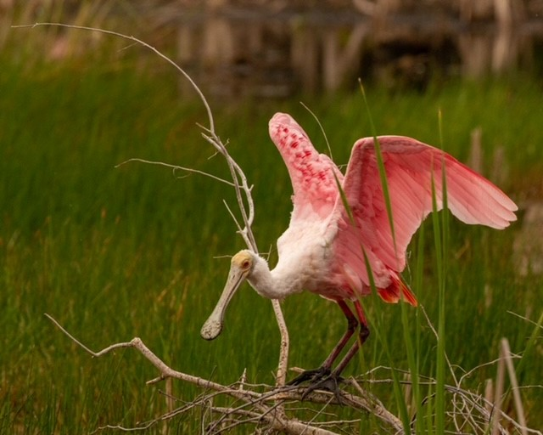
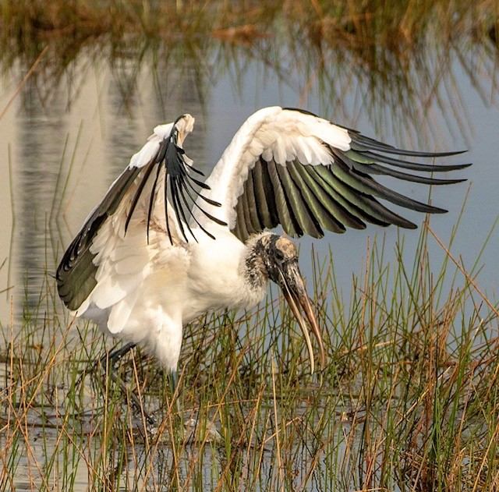
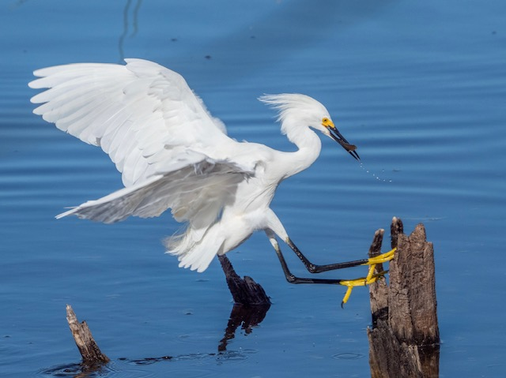
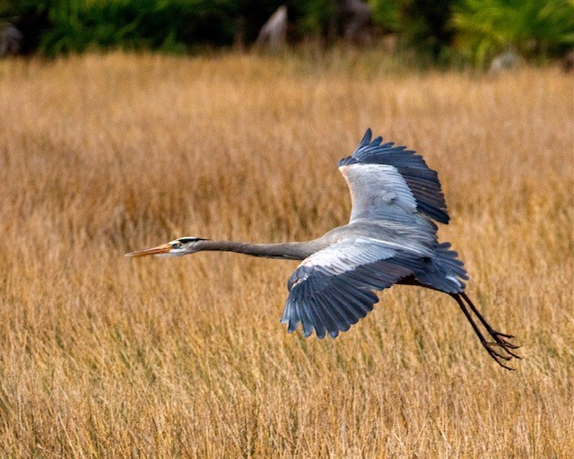
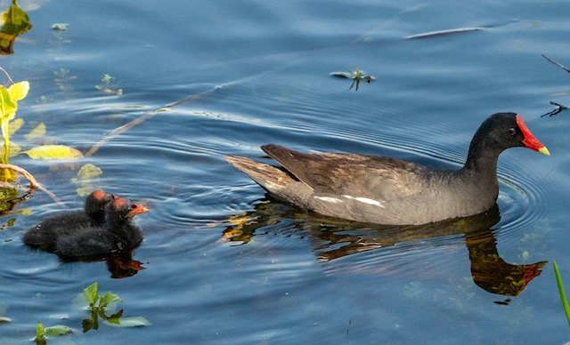
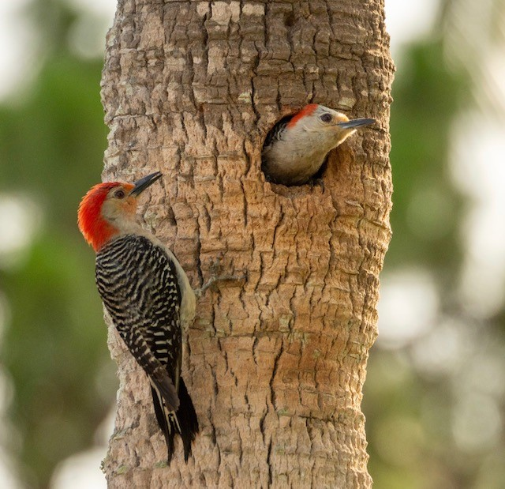
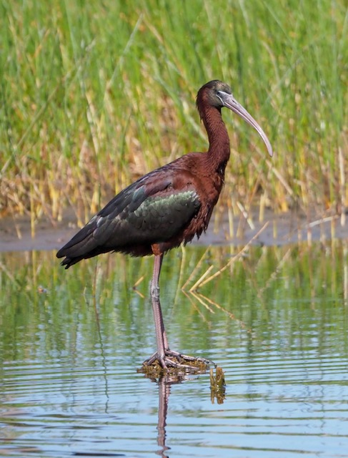
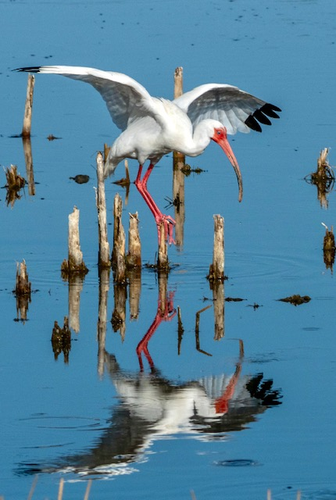
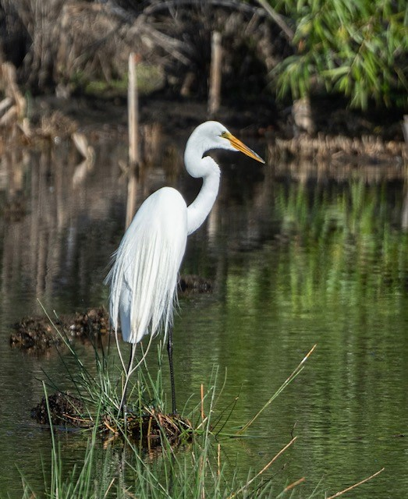
P R O J E C T I D E A S
Wetland Scavenger Hunt!
Can you find all 9 species!
Description
Take a look around Bonita Bay and see what you find!
The photos below are some of the common wetland birds you’ll find here in Florida. See how many you can find!
Supply List
Ø A Writing Utensil
Ø Binoculars
Ø A Camera to Document Your Sightings! (optional)
Scavenger Hunt Checklist
Roseate Spoonbill (Platalea ajaja)
Wood Stork (Mycteria americana)
Snowy Egret (Egretta thula)
Great Blue Heron (Ardea Herodias)
Common Moorhen (Gallinula chloropus)
Red-bellied Woodpecker (Melanerpes carolinus )
Glossy Ibis (Plegadis falcinellus)
American White Ibis (Eudocimus albus)
Great Egret (Ardea alba)
MaciasWildlifeSociety.org | The Macias Wildlife Society is a 501(c)(3) corporation. All donations are tax deductible | PO Box 366002, Bonita Springs, FL 34136

